Slide 1

전북대학교
Data Analysis with R
202055132
Yedomon

Slide 2
Plan
Context
Analysis of variance
LSD test of comparison
Plot a bar graph

Slide 3



Context
© https://www.anveshan.farm/products/wood-pressed-black-sesame-oil

Slide 4
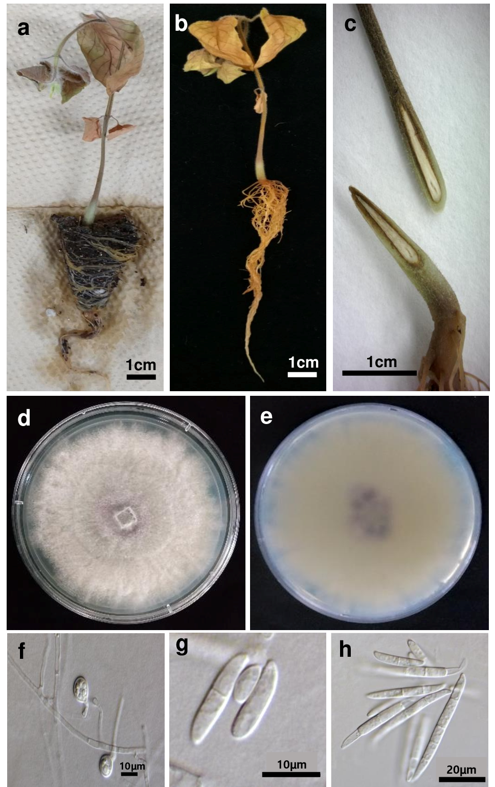
Context
01. Morphological characterization
Sesame wilt disease
© Jin & Yedomon (2021)

Slide 5
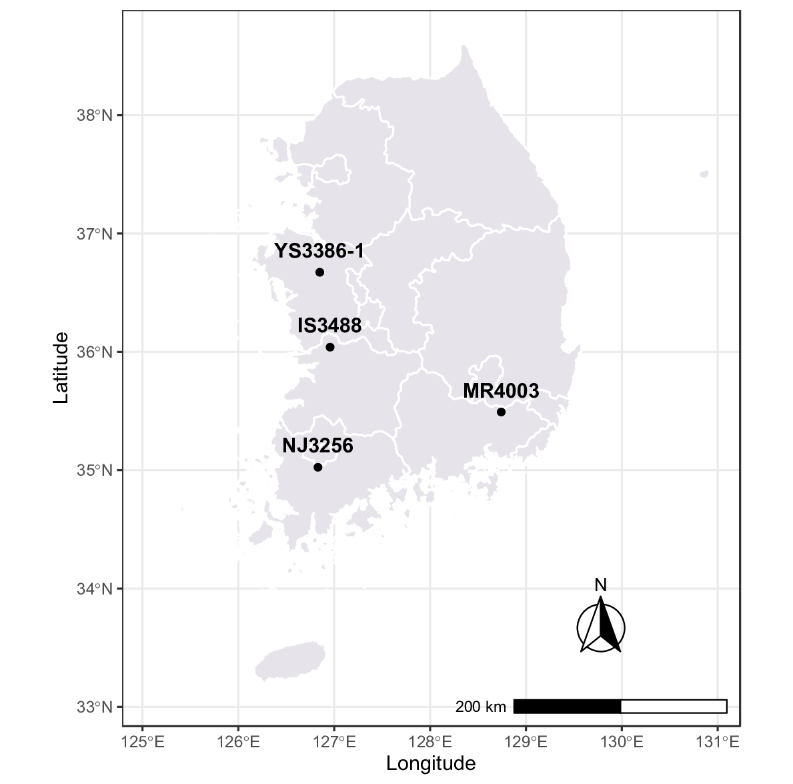
Context
03. Samples collection
Miryang
Yesan
Iksan
Naju
© Jin & Yedomon (2021)

Slide 6
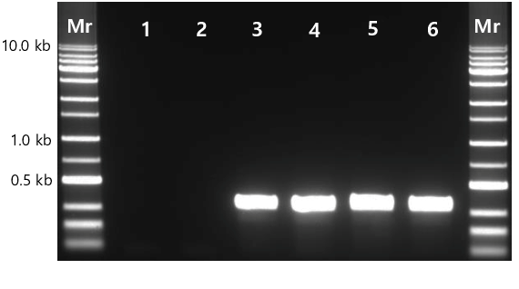
Context
04. Molecular validation of the genus
© Jin & Yedomon (2021)

Slide 7
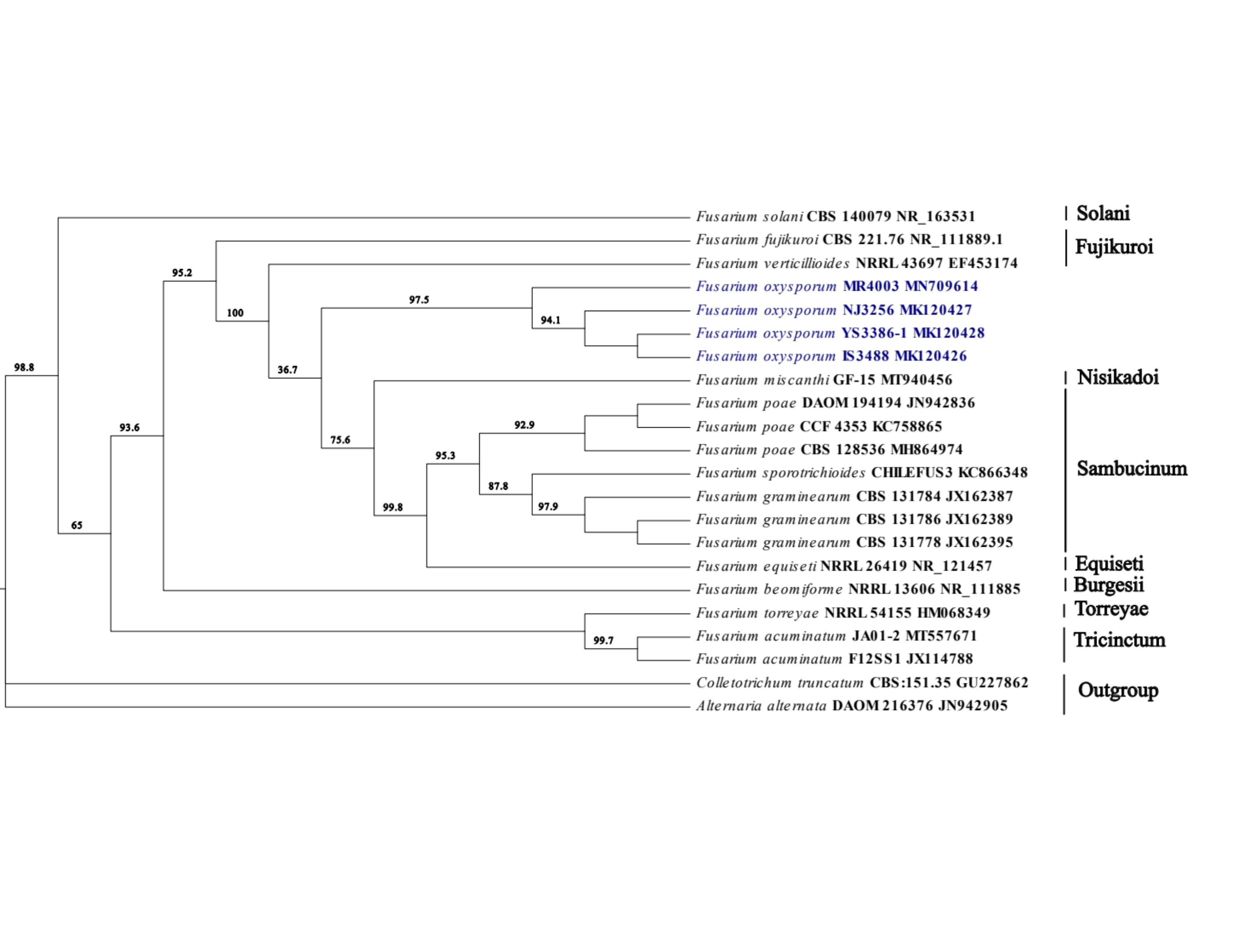
Context
05. Phylogenetic reconstruction
© Jin & Yedomon (2021)

Slide 8

Context
The scientific questions are:
What is the level of pathogenicity of the fungi?
Among the tested Korean cultivar, which are more resistant?

Slide 9

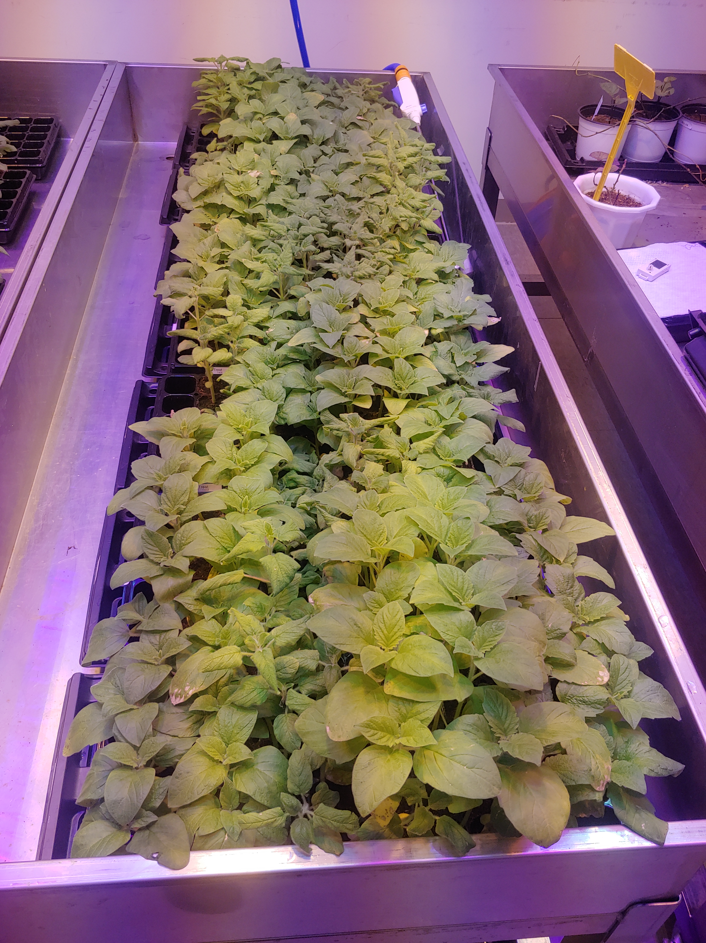
Methodology
33 Korean cultivars
5 replicates
Plant height
Diameter
Leaf length
Leaf width
Chlorophyll content
LED light
25ºC Day 40% RH
22ºC Night 40% RH

Slide 10
Methodology
Analysis of variance → Recorded data
SNK test of comparison → Compare treatments
Multivariate analysis → Identify tolerant and susceptible cultivars

Slide 11

Before starting
Set your own working directory
setwd("C:/Users/ange_/Downloads/r_tuto")
Install required packages via command line:
package agricolae :
install.packages("agricolae", depencies = TRUE)
package ggplot2:
install.packages("ggplot2", depencies = TRUE)
package pachwork:
install.packages("patchwork", depencies = TRUE)
package ggsignif :
install.packages("ggsignif, dependencies = TRUE)
Check if the packages are well installed
library(agricolae)
library(ggplot2)
library(ggsignif)

Slide 12
Analysis of variance
01. ANOVA
## Data importation
data_y = read.csv("YS3386.csv",sep = "," , h = T)
## ANOVA for plant height
model<-aov(Height~Type, data=data_y)# the model
anova(model) # get ANOVA table

Slide 13
Mean comparison
02. Least Significant Difference test
LSD.test(model, "Type", group=FALSE, p.adj= "bon",console=TRUE)

Slide 14
Bar graph
03. Plot
data_h = read.csv("height.csv",sep = "," , h = T)
h = ggplot(data_h, aes(x = Type, y = Mean, fill = Type)) +
geom_bar(stat = "identity", width = 0.8, show.legend = FALSE) +
labs(x = "Treatment", y = "Plant height (cm)")+
geom_errorbar(aes(ymin = Mean-sd, ymax = Mean + sd), width = 0.2)+
geom_signif(comparisons = list(c("Control", "Infected")),
annotations="***", y_position = 10, tip_length = 0.03) +
theme_bw()+
theme(axis.text = element_text(colour = "black", face = "bold"),
axis.title = element_text(colour = "black", face = "bold") ) +
ggtitle('A')+
scale_fill_manual(values=c("#0E6251", "#FF5733"))
h

Slide 15
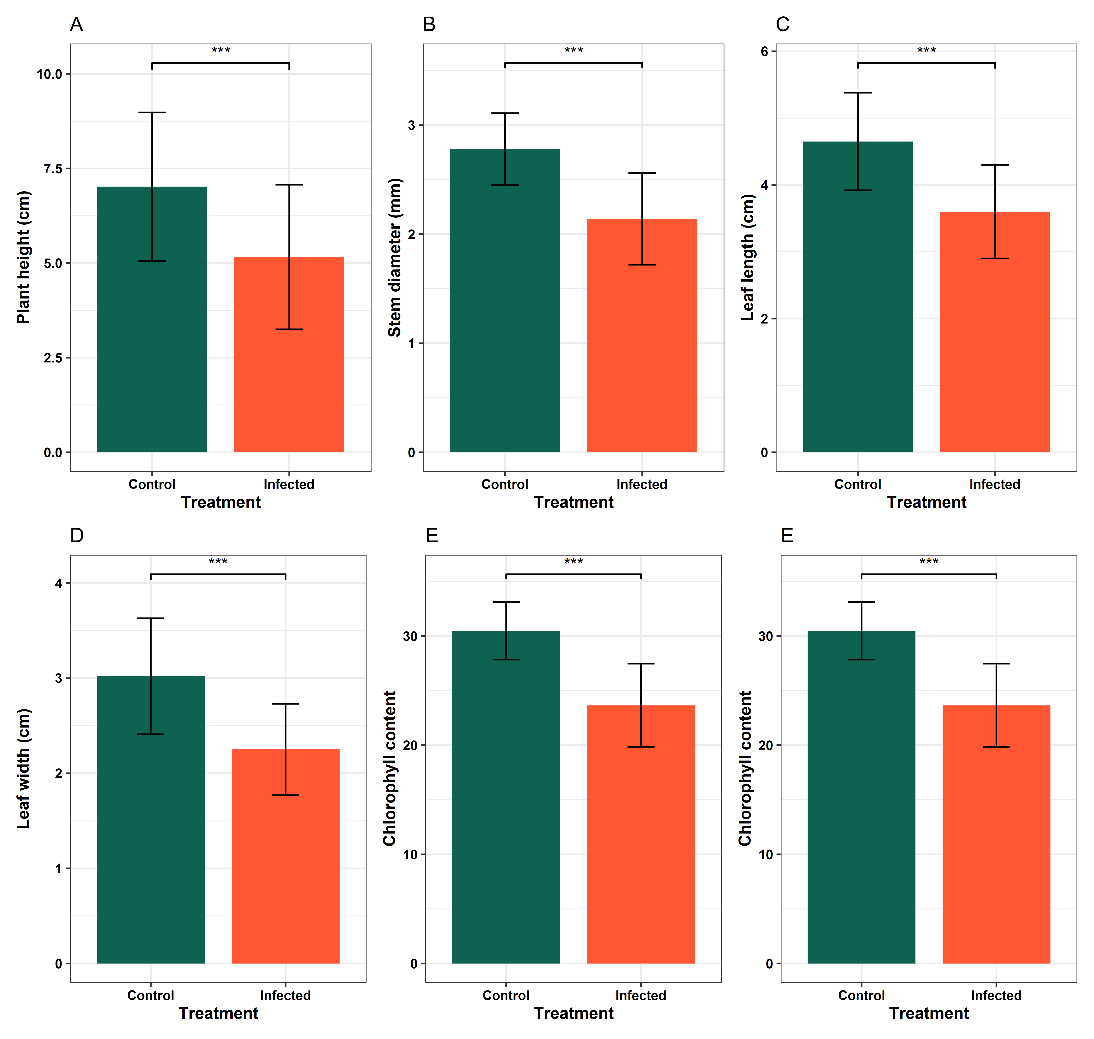
Bar graph
03. Plot

Slide 16
Bar graph
03. Plot & Save
figure = (h | d | ll) /
(lw | cc | cc)
ggsave(figure, file = "bar_plot.png", limitsize = FALSE, width = 10, height = 9.5, type = "cairo-png", dpi=500)

Slide 17
https://github.com/Yedomon/hands_on_training_r
Kindly find the tutorial on the following site:
Question? Please e-mail me: yedomon@jbnu.ac.kr

Slide 18


